Slide 1
Module 5.1
Storage Management

Slide 2
Storage Management
Overview of Mass Storage Structure
Disk Structure
Disk Scheduling –Algorithms
Disk Management

Slide 3
Objectives
To describe the physical structure of secondary storage devices and its effects on the uses of the devices
To explain the performance characteristics of mass-storage devices
To evaluate disk scheduling algorithms

Slide 4
Overview of Mass Storage Structure
Magnetic disks provide bulk of secondary storage of modern computers
  Drives rotate at 60 to 250 times per second
Disks can be removable
Drive attached to computer via I/O bus
  Busses vary, including EIDE, ATA, SATA, USB, Fibre Channel, SCSI, SAS, Firewire
  Host controller in computer uses bus to talk to disk controller built into drive or storage array

Slide 5

Moving-head Disk Mechanism

Slide 6

Hard Disks
Platters range from .85” to 14” (historically)
  Commonly 3.5”, 2.5”, and 1.8”
Range from 30GB to 3TB per drive
Performance
  Transfer Rate – theoretical – 6 Gb/sec
  Effective Transfer Rate – real – 1Gb/sec
  Seek time from 3ms to 12ms – 9ms common for desktop drives
  Average seek time measured or calculated based on 1/3 of tracks
  Latency based on spindle speed
    1 / (RPM / 60) = 60 / RPM
  Average latency = ½ latency
(From Wikipedia)

Slide 7
Hard Disk Performance
Access Latency = Average access time = average seek time + average latency
  For fastest disk 3ms + 2ms = 5ms
  For slow disk 9ms + 5.56ms = 14.56ms
Average I/O time = average access time + (amount to transfer / transfer rate) + controller overhead
For example to transfer a 4KB block on a 7200 RPM disk with a 5ms average seek time, 1Gb/sec transfer rate with a .1ms controller overhead =
  5ms + 4.17ms + 0.1ms + transfer time =
  Transfer time = 4KB / 1Gb/s * 8Gb / GB * 1GB / 1024²KB = 32 / (1024²) = 0.031 ms
  Average I/O time for 4KB block = 9.27ms + .031ms = 9.301ms

Slide 8

The First Commercial Disk Drive
1956
IBM RAMDAC computer included the IBM Model 350 disk storage system
5M (7 bit) characters
50 x 24” platters
Access time = < 1 second

Slide 9
Disk Structure
Disk drives are addressed as large 1-dimensional arrays of logical blocks, where the logical block is the smallest unit of transfer
  Low-level formatting creates logical blocks on physical media
The 1-dimensional array of logical blocks is mapped into the sectors of the disk sequentially
  Sector 0 is the first sector of the first track on the outermost cylinder
  Mapping proceeds in order through that track, then the rest of the tracks in that cylinder, and then through the rest of the cylinders from outermost to innermost
  Logical to physical address should be easy
    Except for bad sectors
    Non-constant # of sectors per track via constant angular velocity

Slide 10
Terminologies
Seek Time: Seek time is the time taken to locate the disk arm to a specified track where the data is to be read or write. So the disk scheduling algorithm that gives minimum average seek time is better.
Rotational Time: Time taken for one full rotation (360 degree)
Rotational Latency:
Rotational Latency is the time taken by the desired sector of disk to rotate into a position so that it can access the read/write heads. So the disk scheduling algorithm that gives minimum rotational latency is better.
(half of rotational time)
Transfer Time:
the time to transfer the data. It depends on the rotating speed of the disk and number of bytes to be transferred.
  Transfer time= Data to be transferred/ Transfer rate.
  Transfer rate = (No of heads*capacity of one track* no of rotations in one sec)

Slide 11
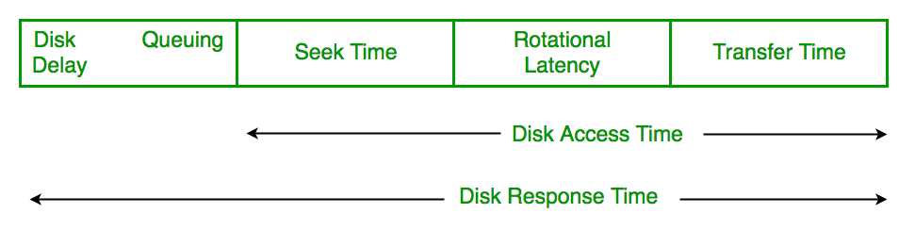

Terminologies
Disk Access Time = Seek Time + Rotational Latency + Transfer Time+Controller Overhead
Disk Response Time: Response Time is the average of time spent by a request waiting to perform its I/O operation

Slide 12
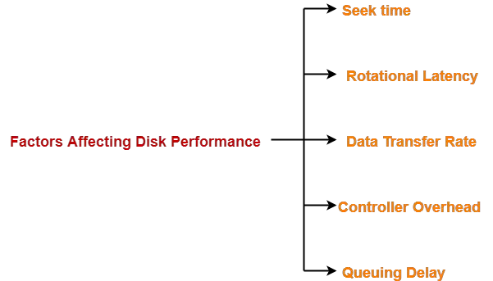

Slide 13
Problem 01
Consider a disk pack with the following specifications- 16 surfaces, 128 tracks per surface, 256 sectors per track and 512 bytes per sector.
Answer the following questions-
1) What is the capacity of disk pack?
2) What is the number of bits required to address the sector?
3) If the disk is rotating at 3600 RPM, what is the data transfer rate?
4) If the disk system has rotational speed of 3000 RPM, what is the average access time with a seek time of 11.5 msec?

Slide 14
Solution
1) Capacity of disk pack
= Total number of surfaces x Number of tracks per surface x Number of sectors per track x Number of bytes per sector
= 16 x 128 x 256 x 512 bytes
= 228 bytes
= 256 MB

Slide 15
Solution
2) Number of Bits Required To Address Sector-
Total number of sectors
= Total number of surfaces x Number of tracks per surface x Number of sectors per track
= 16 x 128 x 256 sectors
= 219 sectors
Thus, Number of bits required to address the sector = 19 bits

Slide 16
Solution
3) Data Transfer Rate
Number of rotations in one second
= (3600 / 60) rotations/sec
= 60 rotations/sec
Now, Data transfer rate
= Number of heads x Capacity of one track x Number of rotations in one second
= 16 x (256 x 512 bytes) x 60
= 2⁴ x 2⁸ x 2⁹ x 60 bytes/sec
= 60 x 2²¹ bytes/sec
= 120 MBps

Slide 17
Time taken for one full rotation
= (60 / 3000) sec = (1 / 50) sec
= 0.02 sec
= 20 msec
Average rotational delay
= 1/2 x Time taken for one full rotation = 1/2 x 20 msec
= 10 msec
Now, average access time
= Average seek time + Average rotational delay + Other factors
= 11.5 msec + 10 msec + 0
= 21.5 msec

Slide 18
Problem :02
What is the average access time for transferring 512 bytes of data with the following specifications-
Average seek time = 5 msec
Disk rotation = 6000 RPM
Data rate = 40 KB/sec
Controller overhead = 0.1 msec

Slide 19
1) Time taken for one full rotation
= (60 / 6000) sec= (1 / 100) sec
= 0.01 sec = 10 msec
2) Average rotational delay
= 1/2 x Time taken for one full rotation
= 1/2 x 10 msec = 5 msec
3)
Transfer time
= (512 bytes / 40 KB) sec
= 0.0125 sec = 12.5 msec

Slide 20
Average Access Time-
Average access time
= Average seek time + Average rotational delay + Transfer time + Controller overhead + Queuing delay
= 5 msec + 5 msec + 12.5 msec + 0.1 msec + 0
= 22.6 msec

Slide 21
Problem 3
A certain moving arm disk storage with one head has the following specifications-
Number of tracks per surface = 200
Disk rotation speed = 2400 RPM
Track storage capacity = 62500 bits
Average latency = P msec
Data transfer rate = Q bits/sec
What is the value of P and Q?

Slide 22
Disk Scheduling
The operating system is responsible for using hardware efficiently — for the disk drives, this means having a fast access time and disk bandwidth
Disk scheduling is also known as I/O scheduling.
Minimize seek time
Seek time ≈ seek distance
Disk bandwidth is the total number of bytes transferred, divided by the total time between the first request for service and the completion of the last transfer

Slide 23
Disk Scheduling (Cont.)
There are many sources of disk I/O request
  OS
  System processes
  Users processes
I/O request includes input or output mode, disk address, memory address, number of sectors to transfer
OS maintains queue of requests, per disk or device
Idle disk can immediately work on I/O request, busy disk means work must queue
  Optimization algorithms only make sense when a queue exists

Slide 24
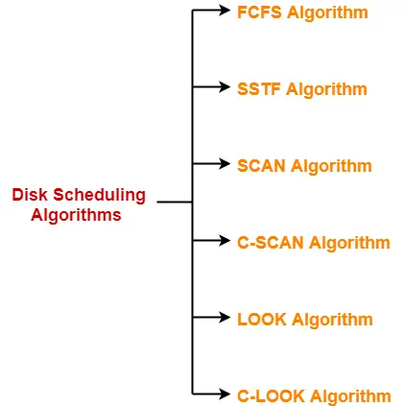

Slide 25
Disk Scheduling (Cont.)
Note that drive controllers have small buffers and can manage a queue of I/O requests (of varying “depth”)
Several algorithms exist to schedule the servicing of disk I/O requests
The analysis is true for one or many platters
We illustrate scheduling algorithms with a request queue (0-199)
98, 183, 37, 122, 14, 124, 65, 67
Head pointer 53

Slide 26

FCFS
Illustration shows total head movement of 640 cylinders

Slide 27
SSTF
Shortest Seek Time First selects the request with the minimum seek time from the current head position
Suppose the order of request is- (82,170,43,140,24,16,190)
And current position of Read/Write head is : 50 (Towards lower number)

Slide 28
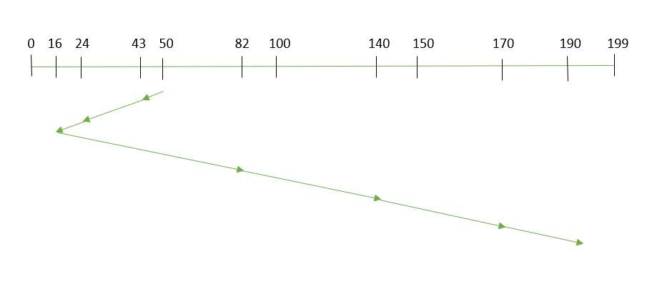
SSTF
SSTF scheduling is a form of SJF scheduling; may cause starvation of some requests
total seek time =(50-43)+(43-24)+(24-16)+(82-16)+(140-82)+(170-140)+(190-170)
=208

Slide 29
SCAN
The disk arm starts at one end of the disk, and moves toward the other end, servicing requests until it gets to the other end of the disk, where the head movement is reversed and servicing continues.
SCAN algorithm Sometimes called the elevator algorithm
Illustration shows total head movement of 236 cylinders
But note that if requests are uniformly dense, largest density at other end of disk and those wait the longest

Slide 30

SCAN

Slide 31
C-SCAN
Provides a more uniform wait time than SCAN
The head moves from one end of the disk to the other, servicing requests as it goes
  When it reaches the other end, however, it immediately returns to the beginning of the disk, without servicing any requests on the return trip
Treats the cylinders as a circular list that wraps around from the last cylinder to the first one
Total number of cylinders?

Slide 32

C-SCAN (Cont.)

Slide 33
LOOK & C-LOOK
LOOK a version of SCAN, C-LOOK a version of C-SCAN
Arm only goes as far as the last request in each direction, then reverses direction immediately, without first going all the way to the end of the disk
Total number of cylinders?

Slide 34
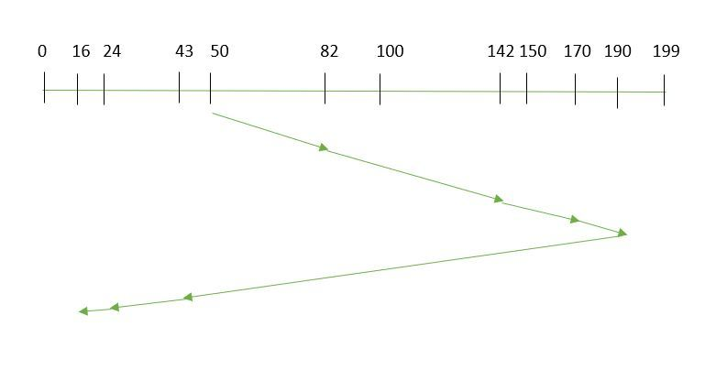
LOOK
requests to be addressed are-82,170,43,140,24,16,190.
And the Read/Write arm is at 50, and it is also given that the disk arm should move “towards the larger value”

Slide 35

C-LOOK (Cont.)

Slide 36
Selecting a Disk-Scheduling Algorithm
SSTF is common and has a natural appeal
SCAN and C-SCAN perform better for systems that place a heavy load on the disk
  Less starvation
Performance depends on the number and types of requests
Requests for disk service can be influenced by the file-allocation method
  And metadata layout
The disk-scheduling algorithm should be written as a separate module of the operating system, allowing it to be replaced with a different algorithm if necessary
Either SSTF or LOOK is a reasonable choice for the default algorithm
What about rotational latency?
  Difficult for OS to calculate
How does disk-based queueing effect OS queue ordering efforts?

Slide 37
Disk Management
Low-level formatting, or physical formatting — Dividing a disk into sectors that the disk controller can read and write
  Each sector can hold header information, plus data, plus error correction code (ECC)
  Usually 512 bytes of data but can be selectable
To use a disk to hold files, the operating system still needs to record its own data structures on the disk
  Partition the disk into one or more groups of cylinders, each treated as a logical disk
  Logical formatting or “making a file system”
  To increase efficiency most file systems group blocks into clusters
    Disk I/O done in blocks
    File I/O done in clusters

Slide 38
Disk Management (Cont.)
Raw disk access for apps that want to do their own block management, keep OS out of the way (databases for example)
Boot block initializes system
  The bootstrap is stored in ROM
  Bootstrap loader program stored in boot blocks of boot partition
Methods such as sector sparing used to handle bad blocks

Slide 39
End of Chapter

